Slide 1
Python ‘IOC’
Klemen Vodopivec, Kay Kasemir,
Feb. 2022

Slide 2
Why Python? Why Python IOC?
Python widely adopted language, easy to learn, develop, test
Large set of readily available high-level functions
  Crunching data (numpy, scipy, etc.)
  Interfacing external sources, ie. databases, web services
When existing EPICS functionality doesn’t cover the new use case…
…but want to use robust EPICS infrastructure
  IOC shell (interactive console, commands, logging)
  Reliable CA & PVA communication
  Archives, alarms, autosave
  GUI tools

Slide 3
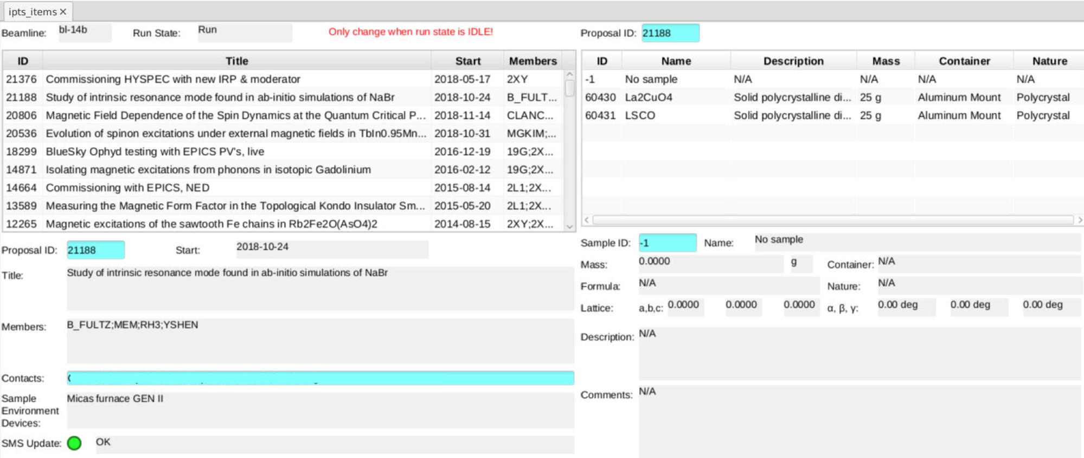
Example: Proposal Database

Slide 4
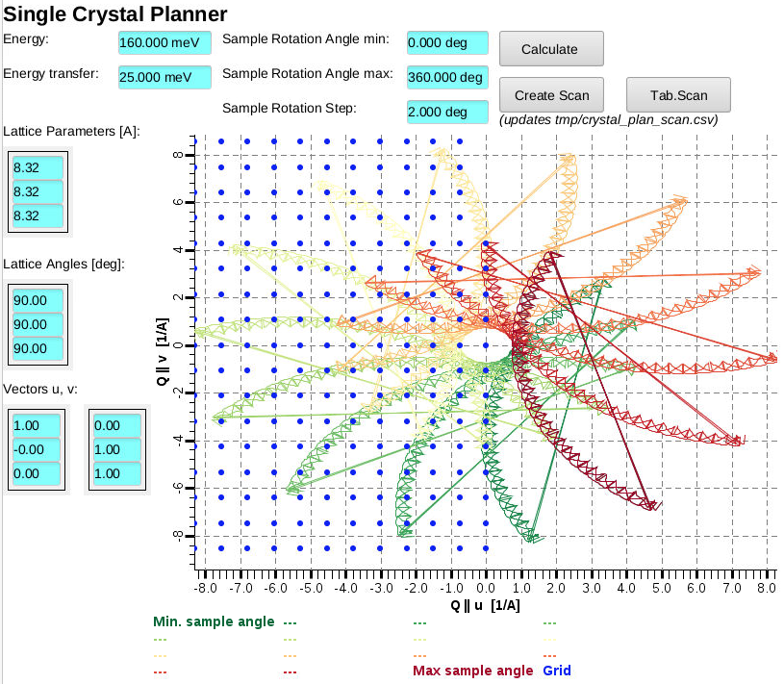
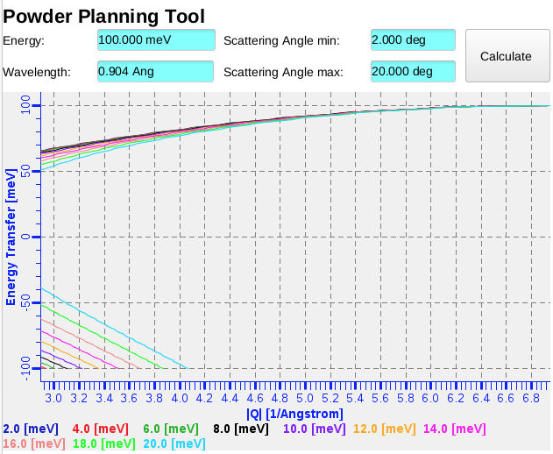
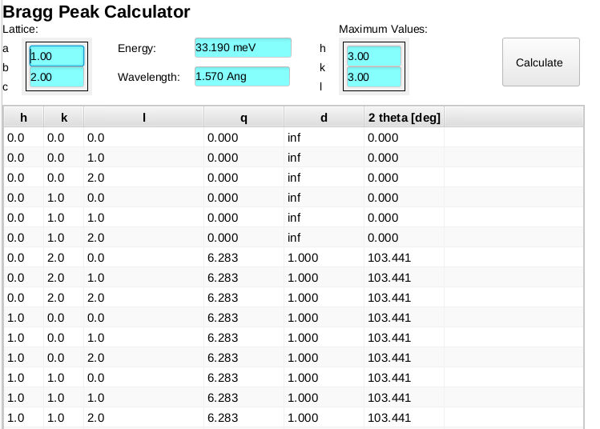
Example: Computations

Slide 5
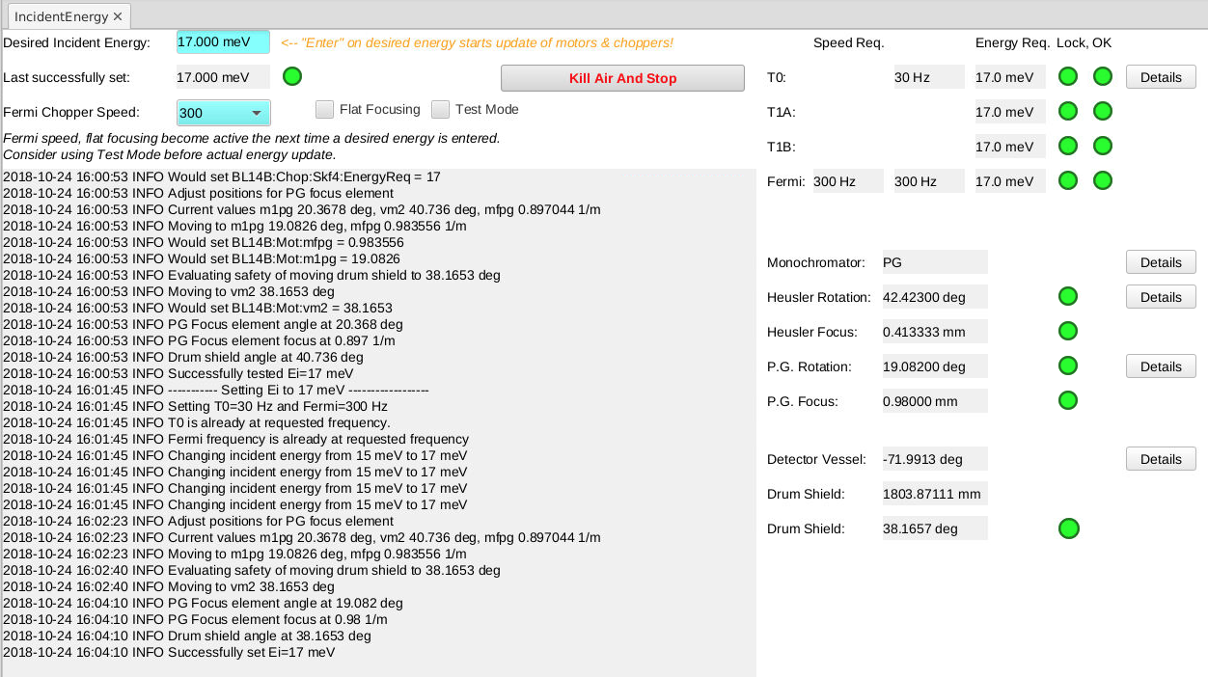
Example: Energy Adjustment
Could use sequencer, but had existing python code

Slide 6
Available Python IOC solutions
pcaspy
https://github.com/paulscherrerinstitute/pcaspy
Most mature, started in 2011
Purely in Python code
But missing EPICS goodies
  autosave, IOC commands
Custom records implementation
  No RTYP, EGU, SCAN etc. fields
  Affects GUI tools
pyDevSup
http://mdavidsaver.github.io/pyDevSup/
Plugs into standard EPICS IOC
Invoked from EPICS records
Invoked Python code must extend provided class
Most flexibility to update records and fields
PyDevice
https://github.com/klemenv/PyDevice
Plugs into existing EPICS IOCs, simplest to use
Invoked from EPICS records
Arbitrary Python code invoked from EPICS records
Can’t change record fields directly
EPICS-independent Python code
  Can be reused or tested outside EPICS environment

Slide 7
pcaspy in more details
Can be used as an EPICS IOC or a client
All code is in Python
  Defining database records
  Serving the connections
  Handling requests
  Interfacing with other IOCs
Needs to reimplement common EPICS functionality
  autosave
  Access Security
  Data types

Slide 8
PyDevice in more details
record(ai, "Example:AbsValue") {
field(DTYP, "pydev")
field(INP, "@abs(VAL)")
}
Call any Python code directly from record
Supports most popular EPICS records
  ai, ao, longin, longout bi, bo, mbbo, mbbi, stringin, stringout, waveform
Pass record fields to Python code
  Values evaluated when record processes
  Return value pushed to record VAL field
  Types automatically converted
Python exceptions translate into SEVR&STAT
caput Example:AbsValue -2.2
record(ai, "Example:Delay") {
field(DTYP, "pydev")
field(INP, "@time.sleep(VAL)")
}
caput –c Example:Delay 5

Slide 9
pcaspy
vs
PyDevice
/ics/examples/python/demo_pcaspy_ioc.py
/ics/examples/db/demo_pyioc.db
from pcaspy import SimpleServer, Driver
import demo
pvdb = { 'random' : {
# 'desc': 'return value between 0 and hilim'
'type' : 'float',
'hilim' : 10 }
}
class DemoDriver(Driver):
def __init__(self):
super(demoDriver, self).__init__()
def read(self, reason):
if reason == 'random':
limit = self.getParamInfo(reason)['hilim']
value = demo.getRandom(limit)
else:
value = self.getParam(reason)
return value
if __name__ == '__main__':
server = SimpleServer()
server.createPV('training:pcaspy:', pvdb)
driver = DemoDriver()
while True:
server.process(0.1)
record(ai, "$(user):random")
{
field(DESC, "Random value in range [0,HOPR]")
field(HOPR, "10")
field(DTYP, "pydev")
field(INP, "@demo.getRandom(HOPR)")
}
/ics/examples/iocBoot/ioc_pydevice/st.cmd
#!../../bin/linux-x86_64/pydevice
< envPaths
epicsEnvSet("PYTHONPATH","$(TOP)/python")
cd "${TOP}"
dbLoadDatabase "dbd/demo_pyioc.dbd"
pydevice_registerRecordDeviceDriver pdbbase
pydev "import demo"
dbLoadRecords "db/pydevice.db","user=training:pydevice"
iocInit
/ics/examples/python/demo.py
import random
def getRandom(limit=1):
# random() returns value in range [0,1]
return random.random() * limit

Slide 10
PyDevice latest: pycalcRecord
New record type to support passing multiple parameters
  Similar to aSub, genSub, calc records
  But evaluate Python code
record(pycalc, "Example:gcd") {
field(INPA, "training:pyioc:X1 CP")
field(INPB, "training:pyioc :Y1 CP")
field(INPC, "training:pyioc :X2 CP")
field(INPD, "training:pyioc :Y2 CP")
field(CALC, "gcd(A,B,C,D)")
}
record(pycalc, "Example:GetHtml") {
field(INPA, "Example:Proto CP")
field(INPB, "Example:Hostname CP")
field(INPC, "Example:Port CP")
field(CALC, "mywebClientFetch(‘A’, ‘B’, C)")
}

Slide 11
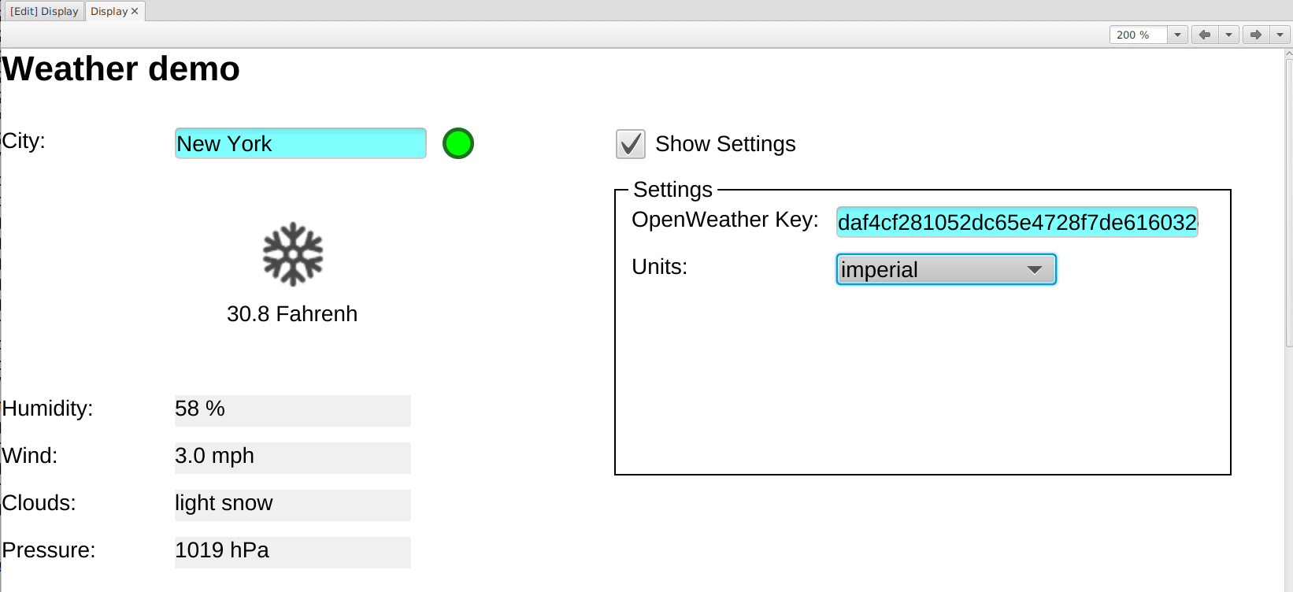
Weather demo

Slide 12
Handling Table, Structure
Yes, pickled byte waveform is a hack
  Requires scripts
  Only works with python as server & client
pvAccess can handle custom structures
  Better for server side
  Client likely needs more than dump of structure;
  Will still require script for user-friendly display.
pvAccess IOC Python libraries
  pvaPy
  p2p

Slide 13
Summary
Python with CA server & client libs can act as IOC
Great tool to have
Doesn’t replace all IOCs

